Slide 1
HEART DISEASE R Project Presentation
BURAK DEMIRCI – 2201292
Kaan Yalman – 2104371

Slide 2
Dataset Selection & Objective
This analysis uses data from Kaggle, and the goal is to analyze as many clinical definitions as possible to create machine learning algorithms that will accurately predict whether someone has a heart condition.
The data set also contains an extensive array of physiological characteristics about individuals. This information can include (but is not limited to) the patient's age, gender, and what type of chest pain they experience, as well as their maximum heart rate. The predictive models will then analyze this data in order to determine any underlying relationships between these variables and an individual's overall cardiovascular health.
HEART DISEASE DATASET URL: https://www.kaggle.com/datasets/johnsmith88/heart-disease-dataset

Slide 3
DATA CLEANING & Preprocessing
At first, data integrity was confirmed by evaluating the dataset for any missing values. After that, data transformation techniques were Applied so that the data could be used by machine learning models.
Categorical variables, including sex, chest pain type, and fasting blood sugar, were converted into factor data types to ensure proper categorical interpretation.
For numeric features such as age, cholesterol levels, and resting blood pressure, standard scaling was applied. This normalization process ensures that distance-based algorithms function optimally without being biased by varying feature scales.
In conclusion, the processed dataset was split into two separate datasets for model evaluation purposes. In this case, the 80% of the overall dataset has been assigned to the training set (to develop the model), whilst the remaining 20% will be used as test data to evaluate how well the model can predict on unseen data.

Slide 4

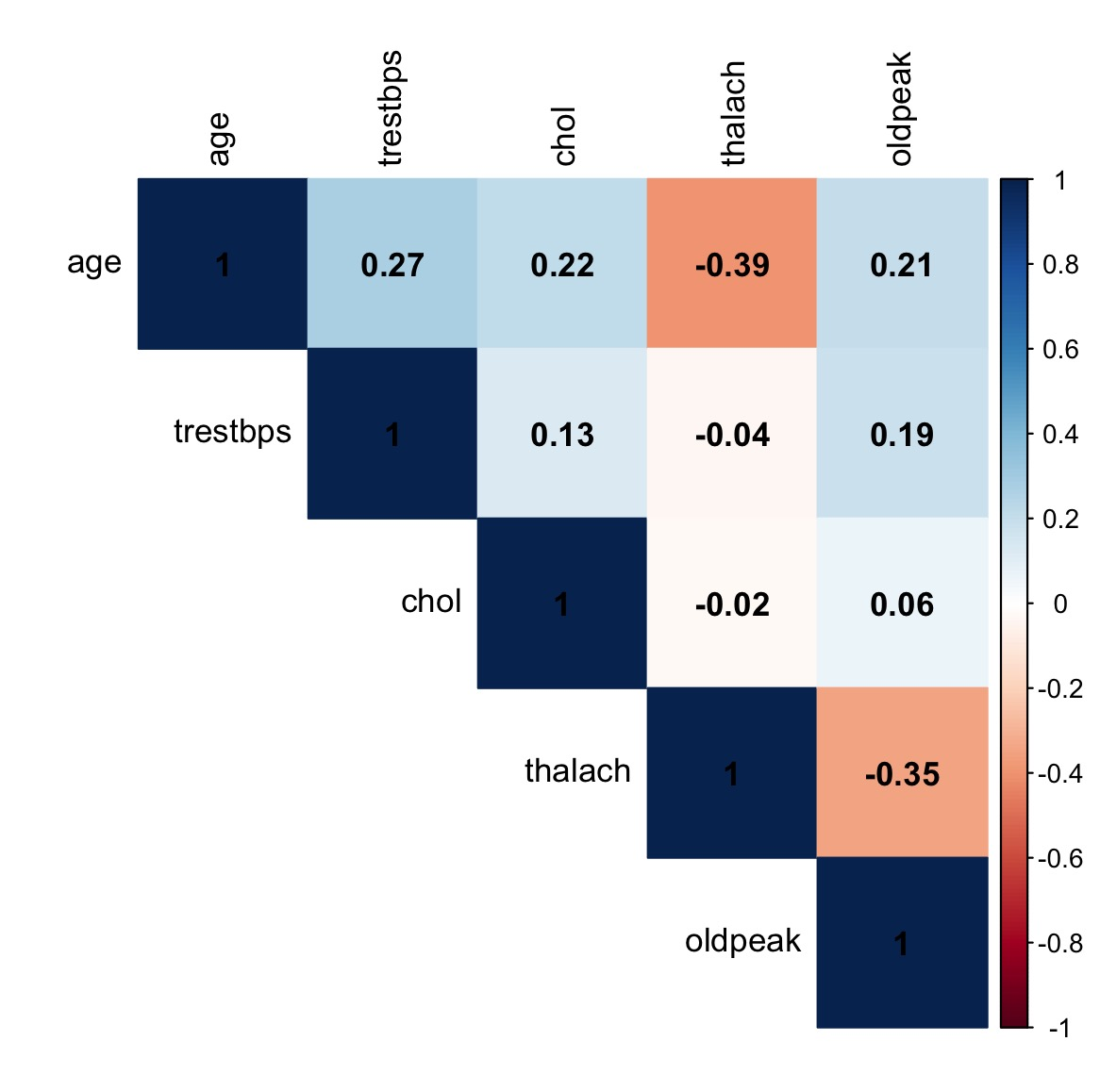
Exploratory Data Analysis: Correlation Matrix
To examine the associations between numeric features, a correlation matrix was created. A strong inverse correlation (-0.39) was noted between the variable Age and the variable Maximum Heart Rate. Other variables had weak linear relationships with each other suggesting there is not a large amount of multicollinearity present between any of the numeric variables.

Slide 5
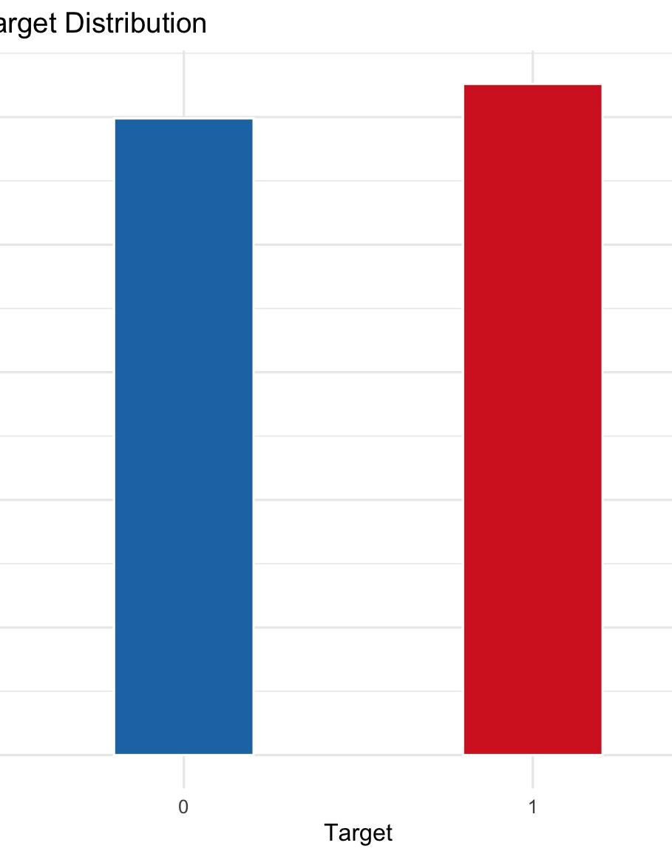
Exploratory Data Analysis: Target Distribution
To determine class imbalance, the distribution of the target variable was visualized. The dataset is balanced; however, there seems to be a slight excess of positive heart disease cases (i.e., Target 1) over negative heart disease cases (i.e., Target 0).

Slide 6
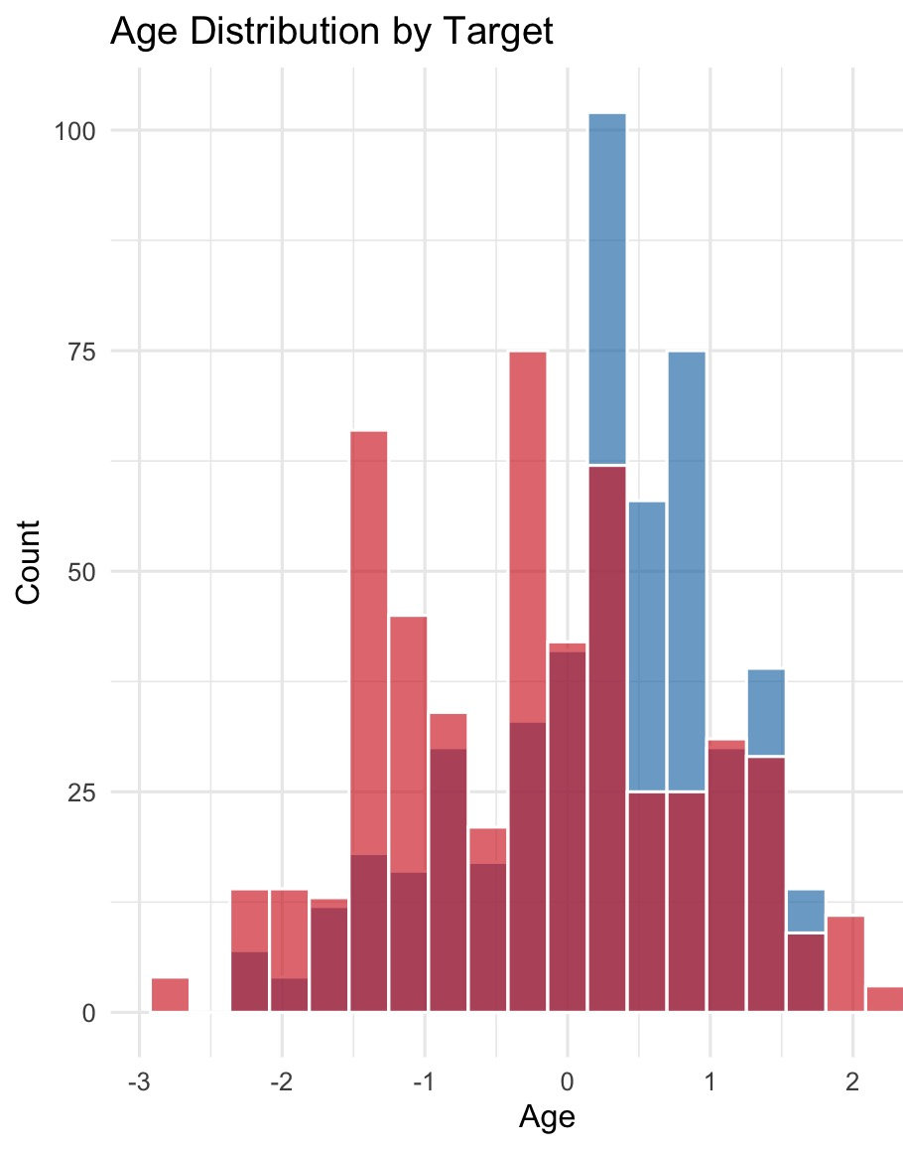
Exploratory Data Analysis: Age Distribution by Target
An overlapping histogram was constructed to evaluate the age profile of each of the target classes. Positive cases (Target 1) fall into a significant concentration in the middle-age range, while negative cases (Target 0) have a somewhat older demographic distribution.

Slide 7
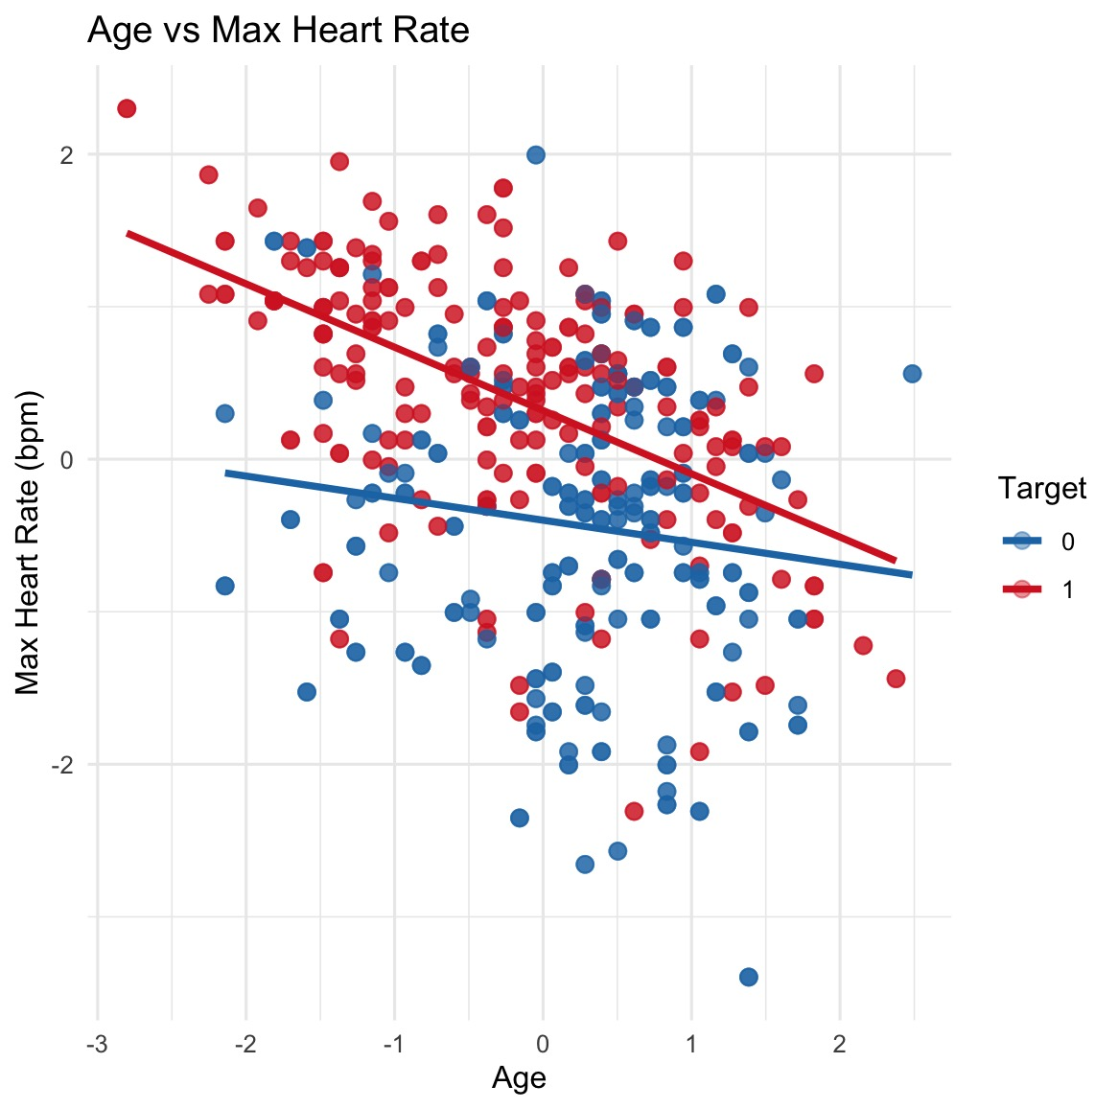
Exploratory Data Analysis: Age / Max Heart Rate
The analysis of the connection between age and maximum heart rate was accomplished through the usage of regression lines and a scatterplot. The downward direction of the slope of the regression lines provides evidence that the maximum heart rate on the whole decreases as the age of the patient increases across diagnostic groups.

Slide 8
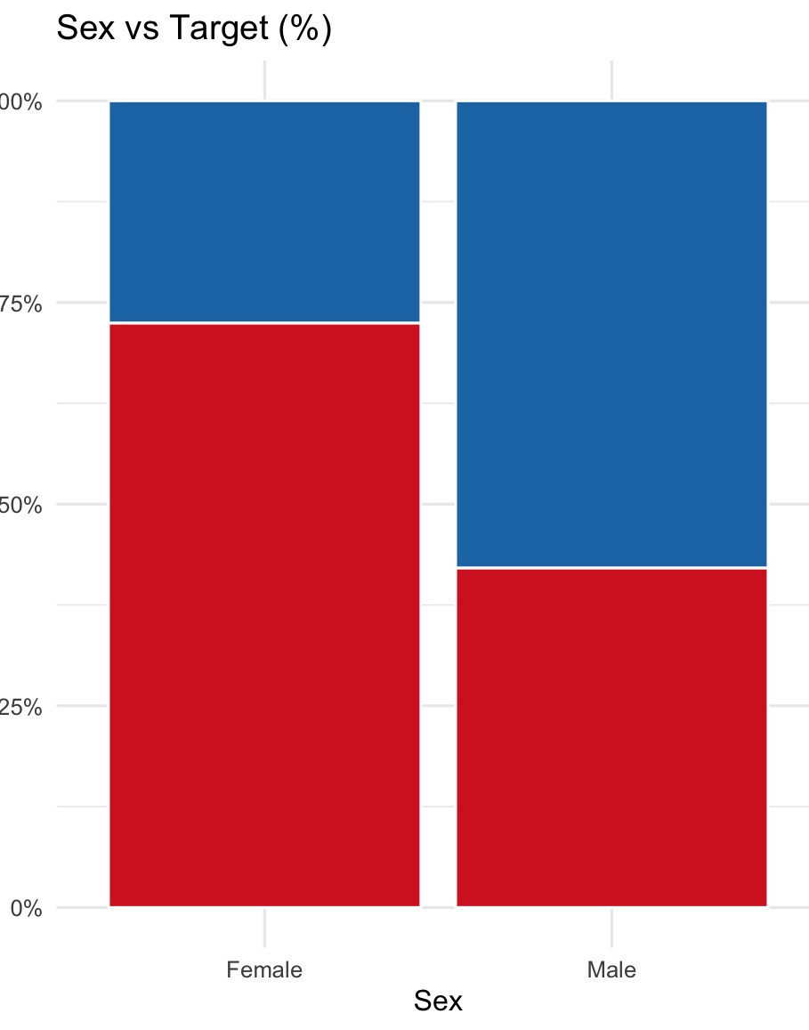
Exploratory Data Analysis: GENDER / Target
Using a proportional bar graph to display heart disease prevalence based on gender shows that females in this sample have a noticeably higher rate of having been diagnosed with heart disease, compared to their male counterparts.

Slide 9
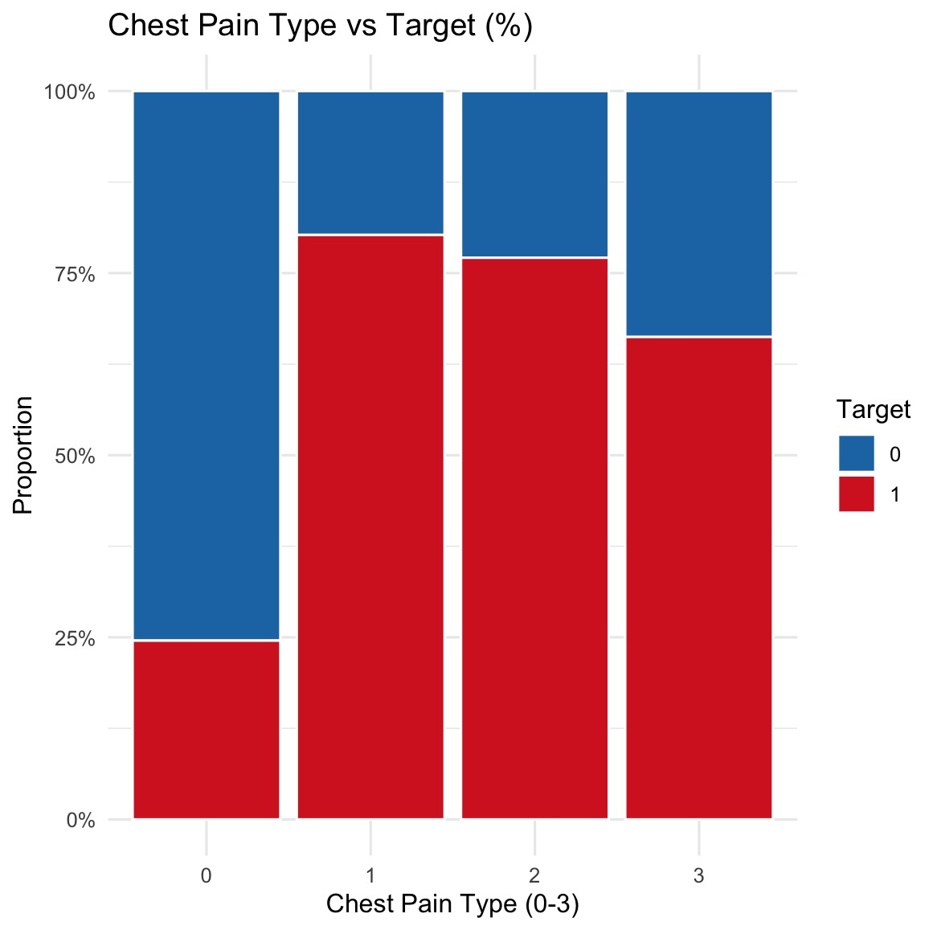
Exploratory Data Analysis: Chest Pain Type / Target
A stacked bar graph was created to assess the ratios of different provides of chest discomfort. The data clearly shows that types 1, 2, and 3 have a much higher degree of association with a positive heart disease diagnosis than an asymptomatic type (0).

Slide 10

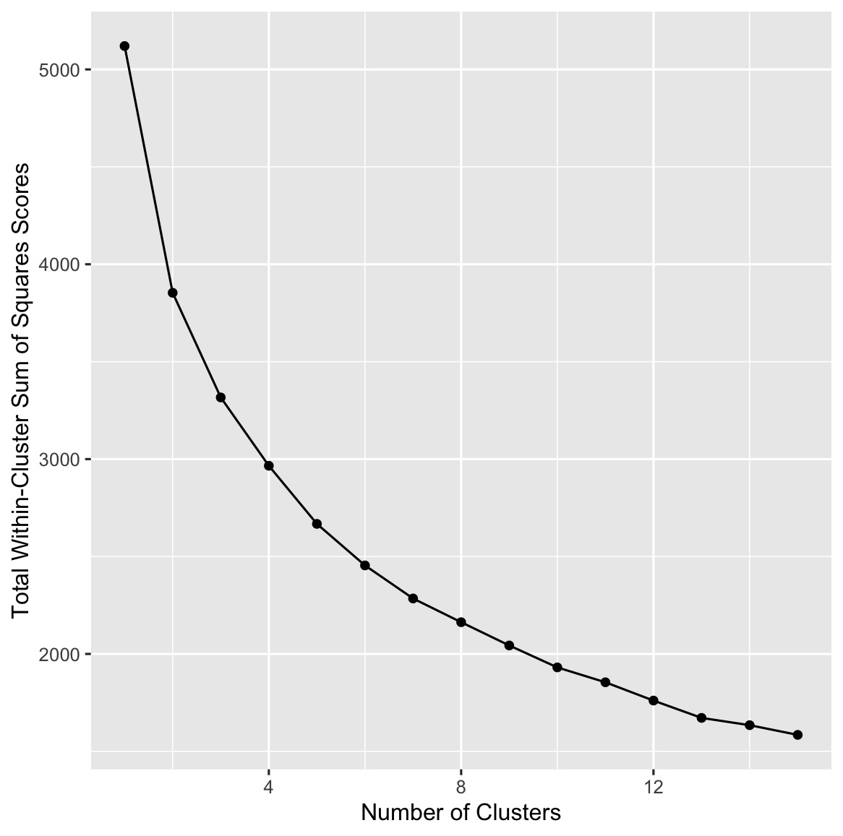
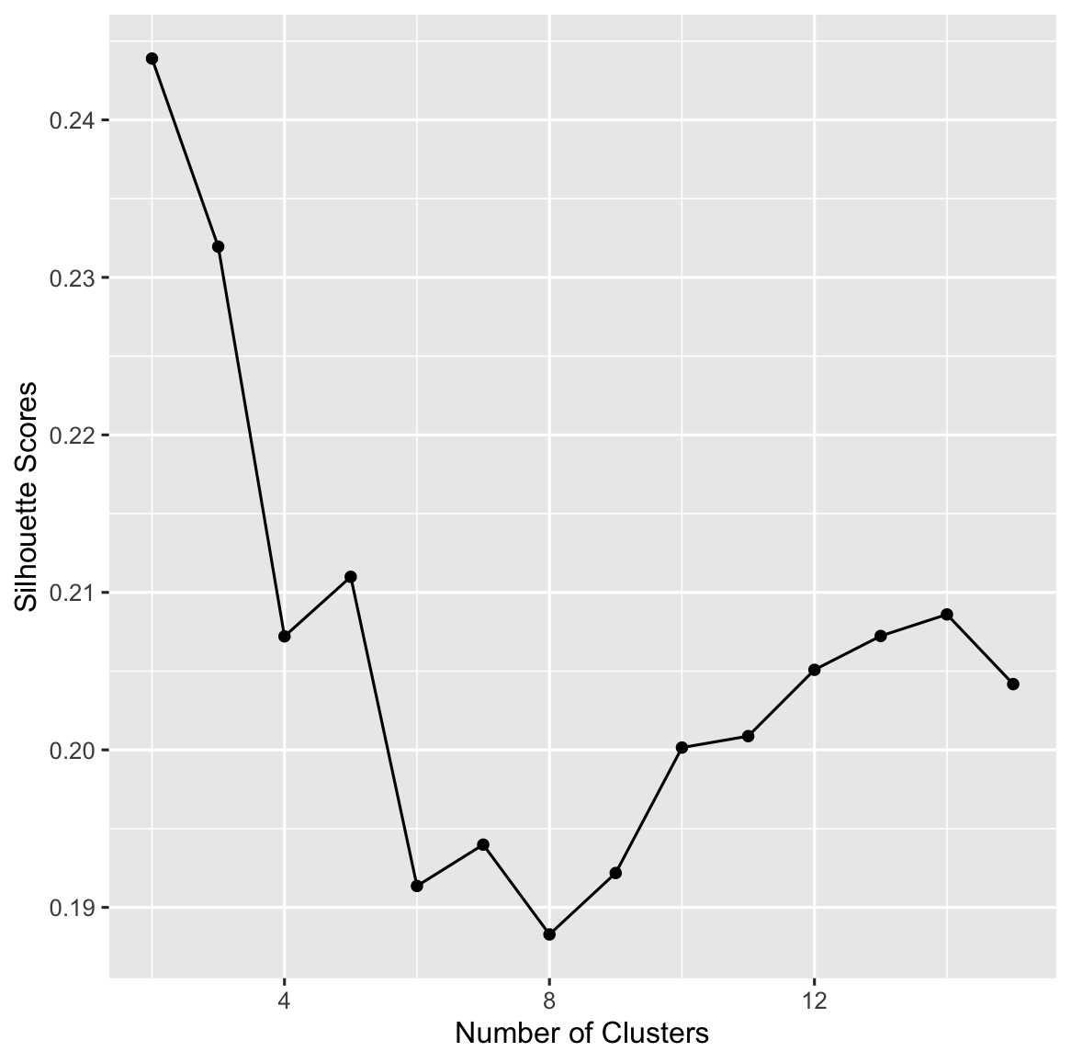
K-means Clustering
Elbow Method
To identify possible natural patient segments, K-Mean clustering with 1 through 15 clusters of only the scaled numeric features was completed in an unsupervised manner. The Elbow method (looking at the Total With-In Cluster Sum of Squares) and Silhouette Scores were used to evaluate the optimal number of groupings.
K=2 yielded the highest silhouette score observed for the data set; however, this was still relatively low (about 0.24). An individual silhouette score of < 0.25 typically indicates that clusters of individuals are likely to be overlapping or the members of both clusters are likely indistinguishable. Therefore, clinical cardiovascular data exist on a continuum in terms of health, suggesting that healthy and ill patients have many similar physiological parameters.
Silhouette Score

Slide 11
SVM Classification
A SVM was chosen because of its ability to accurately classify both original datasets and large datasets. The SVM's configuration uses an RBF kernel and a cost factor of 1; training was then conducted via the 80% split of the data, using the pre-processed/scaled clinical features as a basis to generate the most optimal algorithms.
The confusion matrix shows that the model yielded a total of 90 true positives (TP), 89 true negatives (TN), 11 false positives (FP), and 15 false negatives (FN) when tested on the holdout data. The precision, recall, and F1 score of the model are 0.891, 0.857, and 0.874, respectively, based on these four values. The recall measure is particularly important in the context of medical diagnosis. False negatives can prevent patients with underlying heart disease from being identified and treated appropriately, so eliminating false negatives is critical to providing proper care for patients and avoiding unnecessary morbidity and mortality.

Slide 12
Conclusion & Limitations
In conclusion, the clinical dataset has been adequately prepared for analysis and comprehensive exploration of feature-to-feature relationships has been completed. Two different machine learning techniques have been used to evaluate how well they predicted the outcome variable. The results confirmed that supervised learning (SVM) performed much better than unsupervised clustering (K-Means). Both classifications were affected by the overlap between the clinical predictor variables which prevented the natural segmentation of patient profiles prior to applying target labels.
Although strong performance was achieved, model optimization should be pursued through rigorous hyperparameter tuning.

Slide 13
Thank you for listening

